Slide 1


Lecture 2-5
DLI
Accelerating Convergence

Slide 2
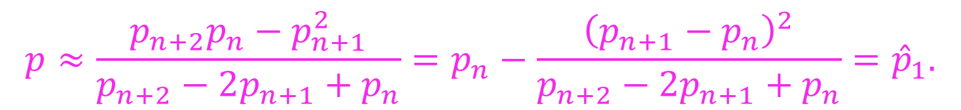
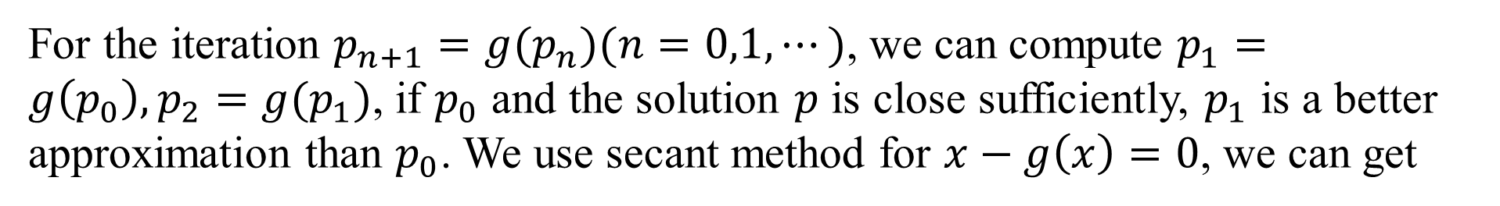

DLI
Aitken’s $∆^{2}$ Method
For the iteration $p_{n+1}=g(p_{n})(n=0,1,⋯)$, we can compute $p_{1}=g\left(p_{0}\right),p_{2}=g(p_{1})$, if $p_{0}$ and the solution $p$ is close sufficiently, $p_{1}$ is a better approximation than $p_{0}$. We use secant method for $x−g\left(x\right)=0$, we can get
$$p≈\frac{p_{n+2}p_{n}−p_{n+1}^{2}}{p_{n+2}−2p_{n+1}+p_{n}}=p_{n}−\frac{{\left(p_{n+1}−p_{n}\right)}^{2}}{p_{n+2}−2p_{n+1}+p_{n}}={\hat{p}}_{1}.$$

Slide 3

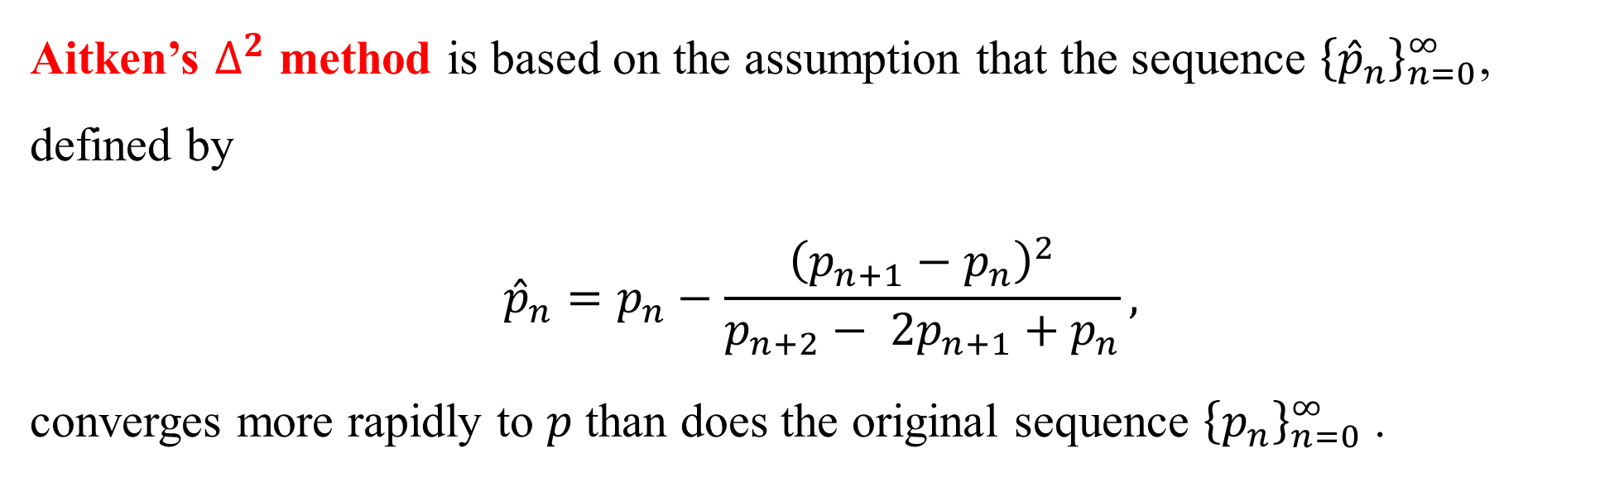
DLI
Aitken’s $∆^{2}$ method is based on the assumption that the sequence ${\left\{{\hat{p}}_{n}\right\}}_{n=0}^{∞}$, defined by
$${\hat{p}}_{n}=p_{n}−\frac{{\left(p_{n+1}−p_{n}\right)}^{2}}{p_{n+2}− 2p_{n+1}+p_{n}},$$
converges more rapidly to $p$ than does the original sequence ${\left\{p_{n}\right\}}_{n=0}^{∞}$ .
The corresponding iteration function is $ψ\left(x\right)=x−\frac{{\left(g\left(x\right)−x\right)}^{2}}{g\left(g\left(x\right)\right)−2g\left(x\right)+x}$.

Slide 4
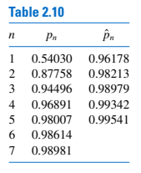
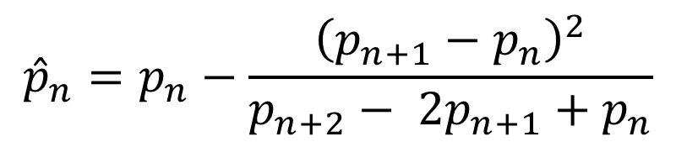
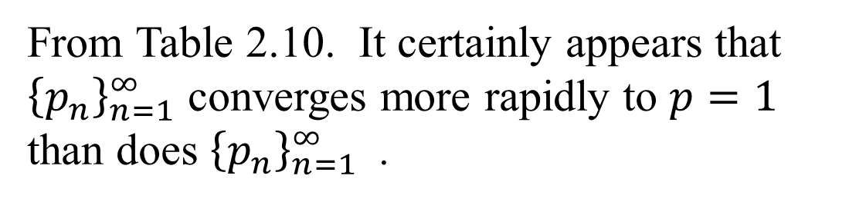
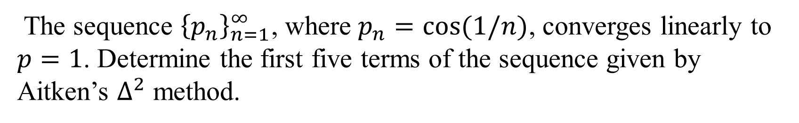
DLI
Example 1
The sequence ${\left\{p_{n}\right\}}_{n=1}^{∞}$, where $p_{n}=cos⁡(1/n)$, converges linearly to $p=1$. Determine the first five terms of the sequence given by Aitken’s $∆^{2}$ method.
Solution:
$${\hat{p}}_{n}=p_{n}−\frac{{\left(p_{n+1}−p_{n}\right)}^{2}}{p_{n+2}− 2p_{n+1}+p_{n}}$$
From Table 2.10. It certainly appears that ${\left\{p_{n}\right\}}_{n=1}^{∞}$ converges more rapidly to $p=1$ than does ${\left\{p_{n}\right\}}_{n=1}^{∞}$ .

Slide 5
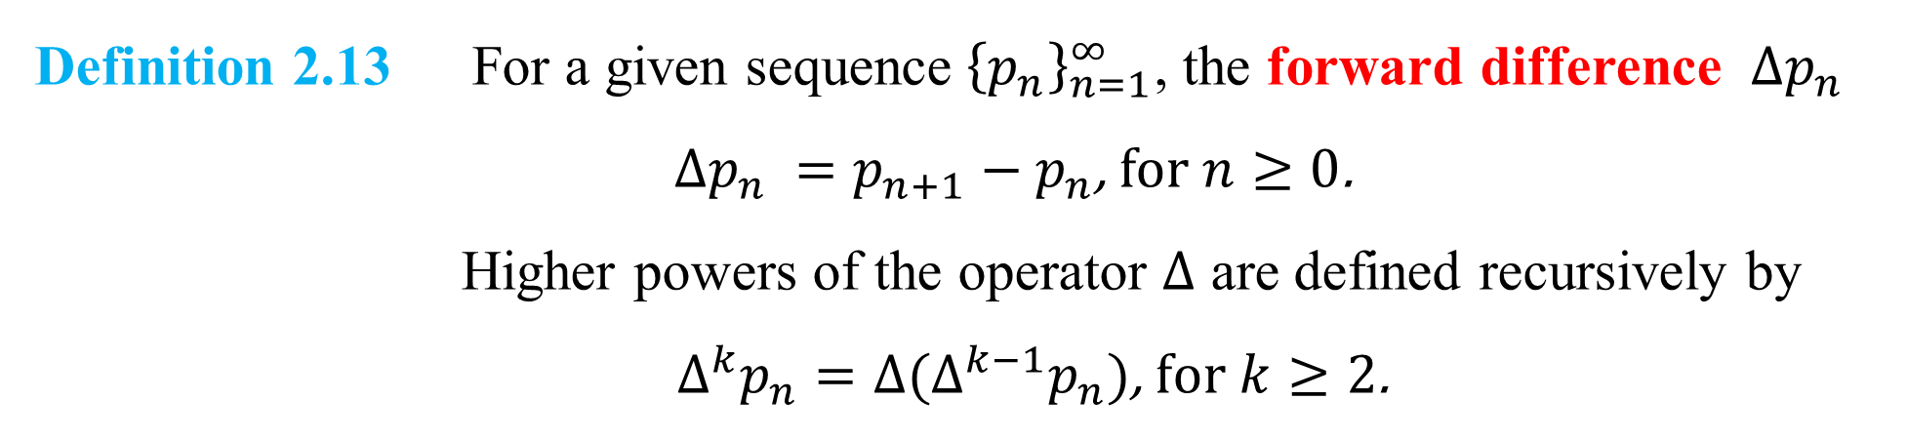
DLI
The $∆$ notation of Aitken’s $∆^{2}$ method
Definition 2.13 For a given sequence ${\left\{p_{n}\right\}}_{n=1}^{∞}$, the forward difference $∆p_{n}$
$∆p_{n} =p_{n+1}−p_{n}$, for $n≥0$.
Higher powers of the operator $∆$ are defined recursively by
$∆^{k}p_{n}=∆(∆^{k−1}p_{n})\text{,} \text{for} k≥2$.

Slide 6
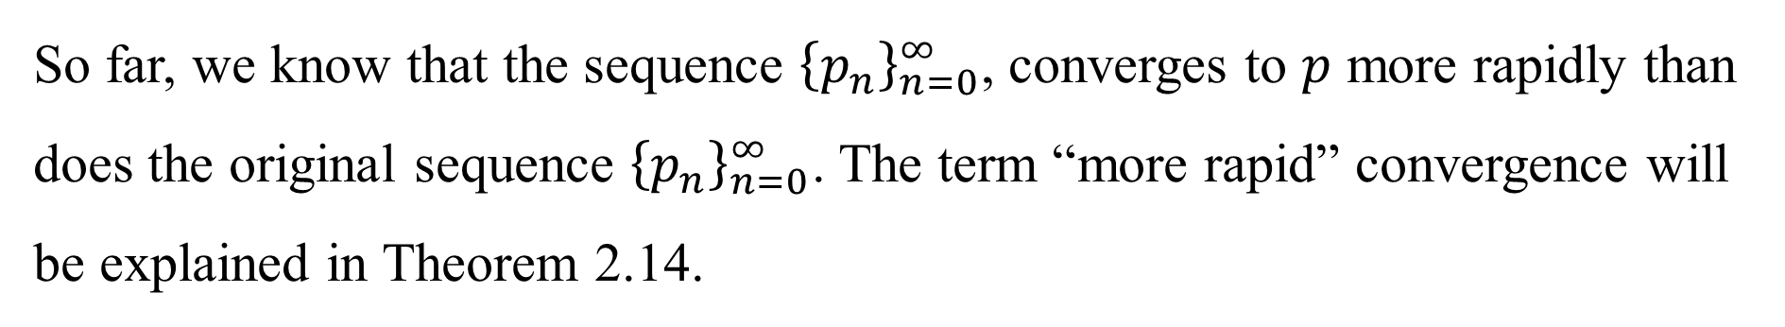
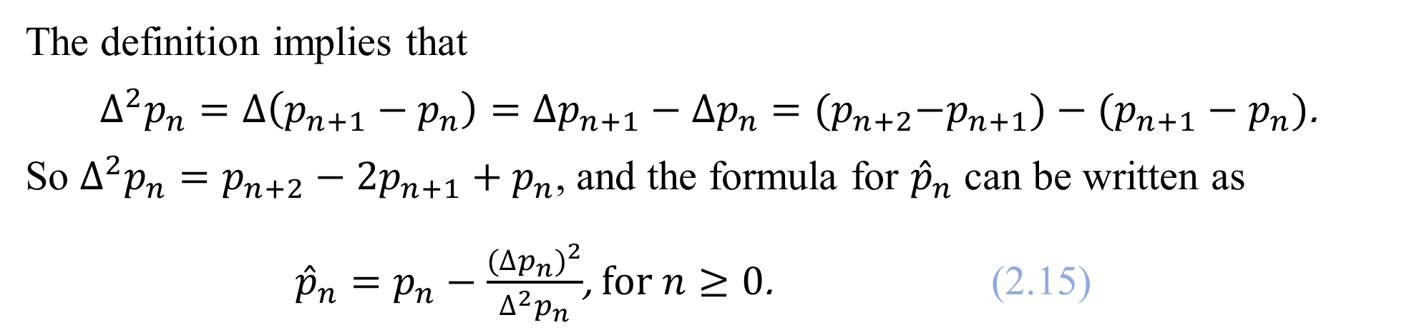
DLI
The definition implies that
$∆^{2}p_{n}=∆\left(p_{n+1}−p_{n}\right)=∆p_{n+1}−∆p_{n}={(p}_{n+2}−p_{n+1})−(p_{n+1}−p_{n})$.
So $∆^{2}p_{n}=p_{n+2}−2p_{n+1}+p_{n}$, and the formula for ${\hat{p}}_{n}$ can be written as
${\hat{p}}_{n}=p_{n}−\frac{{(∆p_{n})}^{2}}{∆^{2}p_{n}}$, for $n≥0$. (2.15)
So far, we know that the sequence ${\left\{p_{n}\right\}}_{n=0}^{∞}$, converges to $p$ more rapidly than does the original sequence ${\left\{p_{n}\right\}}_{n=0}^{∞}$. The term “more rapid” convergence will be explained in Theorem 2.14.

Slide 7
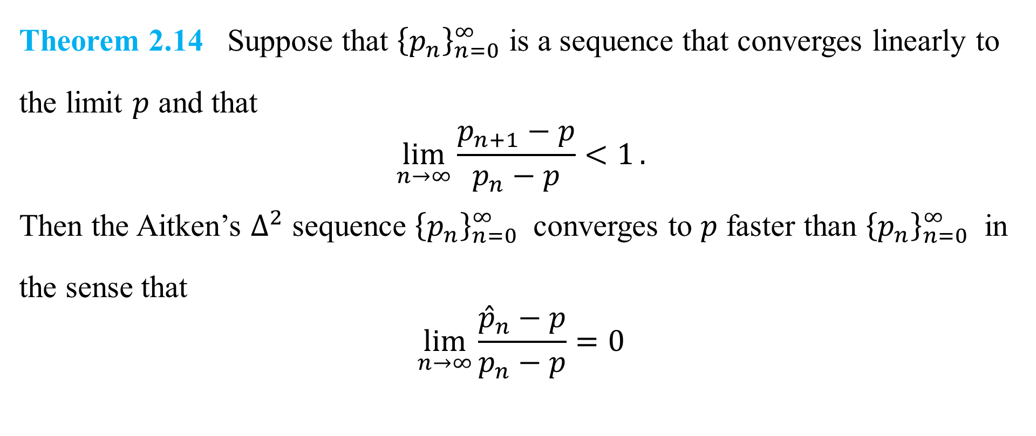
DLI
Theorem 2.14 Suppose that ${\left\{p_{n}\right\}}_{n=0}^{∞}$ is a sequence that converges linearly to the limit $p$ and that
$$\lim_{n→∞}{\frac{p_{n+1}−p}{p_{n}−p}<1}.$$
Then the Aitken’s $∆^{2}$ sequence ${\left\{p_{n}\right\}}_{n=0}^{∞}$ converges to $p$ faster than ${\left\{p_{n}\right\}}_{n=0}^{∞}$ in the sense that
$$\lim_{n→∞}{\frac{{\hat{p}}_{n}−p}{p_{n}−p}=0}$$

Slide 8
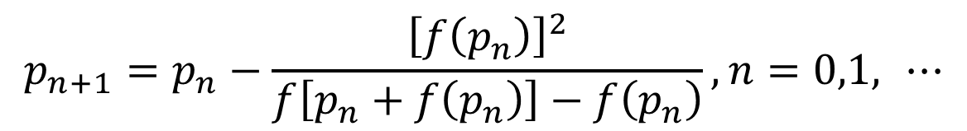
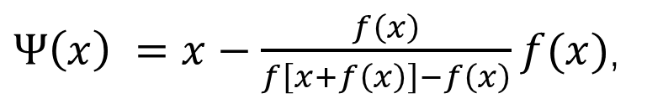
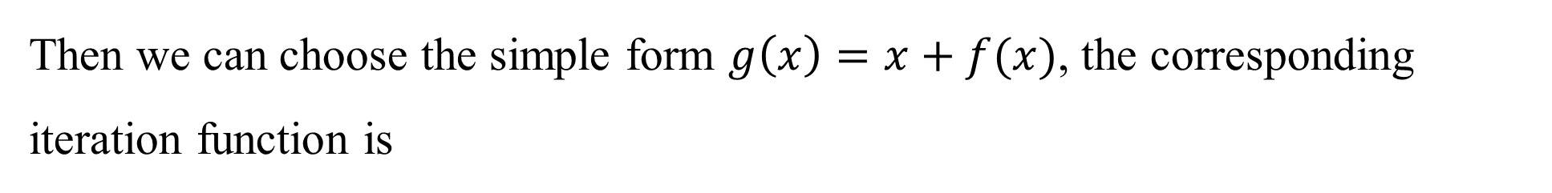
DLI
Steffensen’s Method
Then we can choose the simple form $g\left(x\right)=x+f(x)$, the corresponding iteration function is
$Ψ\left(x\right) =x−\frac{f\left(x\right)}{f\left[x+f\left(x\right)\right]−f\left(x\right)}f(x)$,
$$p_{n+1}=p_{n}−\frac{{\left[f\left(p_{n}\right)\right]}^{2}}{f\left[p_{n}+f\left(p_{n}\right)\right]−f\left(p_{n}\right)},n=0,1, ⋯$$

Slide 9

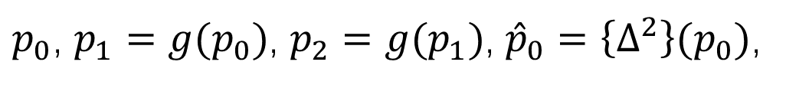
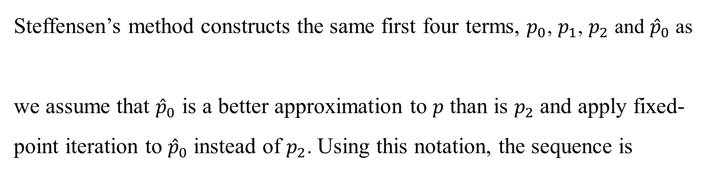
DLI
Steffensen’s method constructs the same first four terms, $p_{0}$, $p_{1}$, $p_{2}$ and ${\hat{p}}_{0}$ as
we assume that ${\hat{p}}_{0}$ is a better approximation to $p$ than is $p_{2}$ and apply fixed-point iteration to ${\hat{p}}_{0}$ instead of $p_{2}$. Using this notation, the sequence is
$p_{0}$, $p_{1}=g(p_{0})$, $p_{2}=g(p_{1})$, ${\hat{p}}_{0}=\left\{∆^{2}\right\}(p_{0})$,
$p_{0}^{(0)}$, $p_{1}^{(0)}=g(p_{0}^{(0)})$, $p_{2}^{(0)}=g(p_{1}^{(0)})$, $p_{0}^{(1)}=\left\{∆^{2}\right\}(p_{0}^{(0)})$, $p_{1}^{(1)}=g\left(p_{0}^{\left(1\right)}\right),…$
Every third term of the Steffensen sequence is generated by Eq. (2.15); the others use fixed-point iteration on the previous term.
${\hat{p}}_{n}=p_{n}−\frac{{(∆p_{n})}^{2}}{∆^{2}p_{n}}$, (2.15)

Slide 10
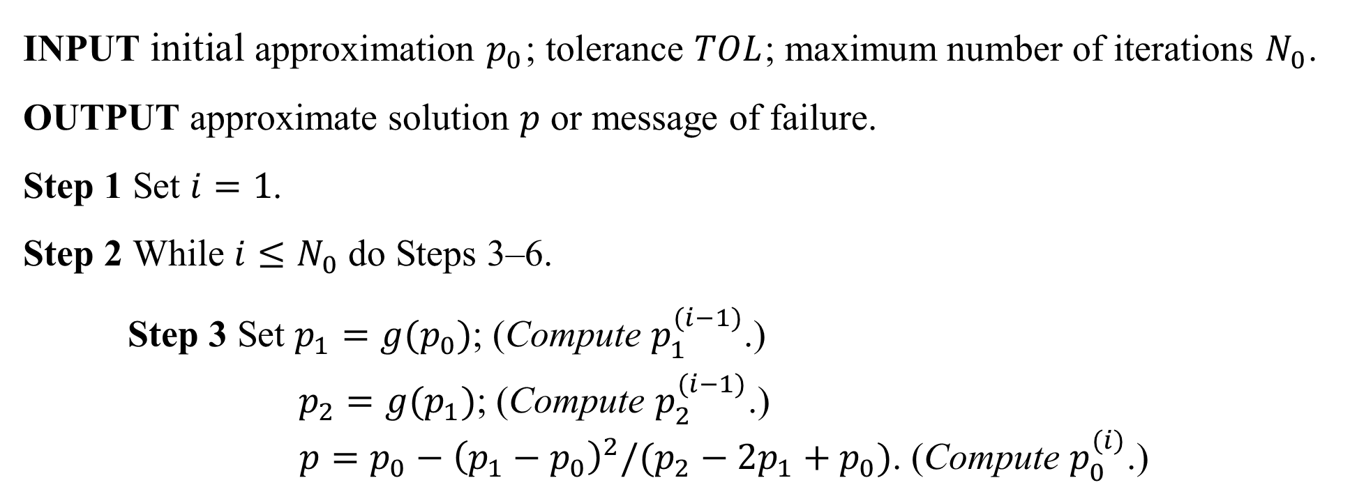
DLI
Algorithm 2.6 Steffensen’s
To find a solution to $p=g(p)$ given an initial approximation $p_{0}$:
INPUT initial approximation $p_{0}$; tolerance $TOL$; maximum number of iterations $N_{0}$.
OUTPUT approximate solution $p$ or message of failure.
Step 1 Set $i=1$.
Step 2 While $i≤N_{0}$ do Steps 3–6.
Step 3 Set $p_{1}=g(p_{0})$; (Compute $p_{1}^{(i−1)}$.)
$p_{2}=g(p_{1})$; (Compute $p_{2}^{(i−1)}$.)
$p=p_{0}−{\left(p_{1}−p_{0}\right)}^{2}/(p_{2}−2p_{1}+p_{0})$. (Compute $p_{0}^{(i)}$.)

Slide 11
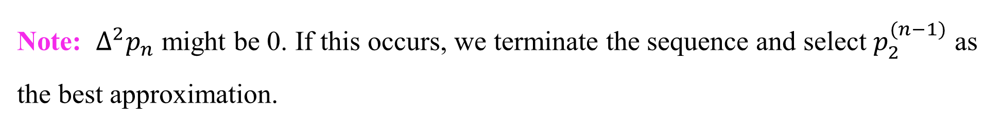
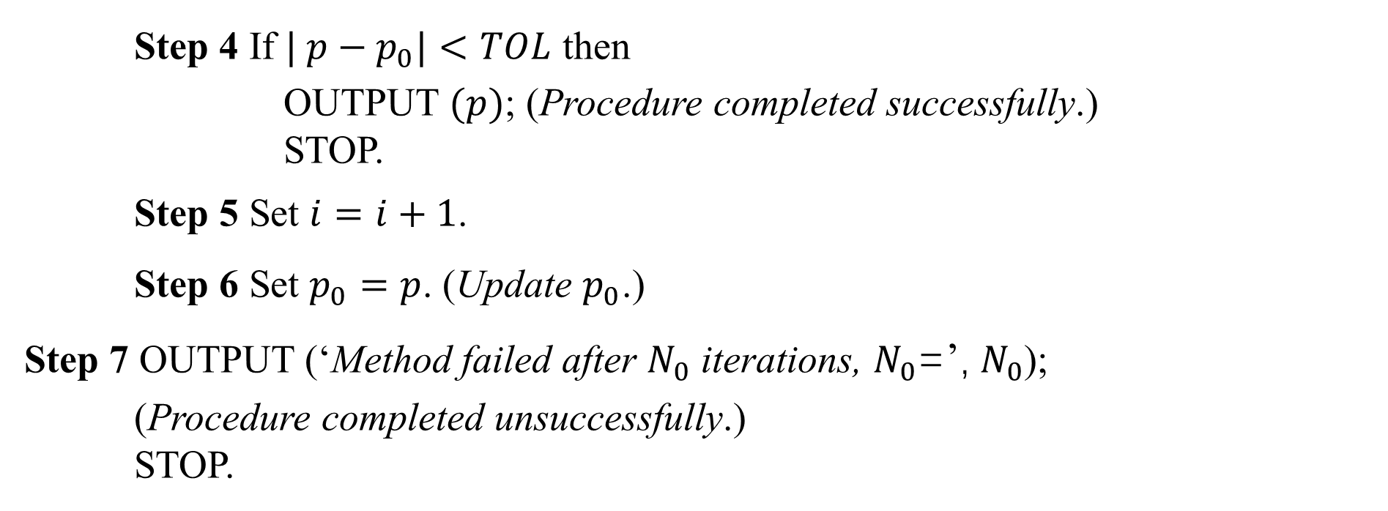
DLI
Step 4 If $| p−p_{0}|<TOL$ then
OUTPUT $(p)$; (Procedure completed successfully.)
STOP.
Step 5 Set $i=i+1$.
Step 6 Set $p_{0}=p$. (Update $p_{0}$.)
Step 7 OUTPUT (‘Method failed after $N_{0}$ iterations, $N_{0}$=’, $N_{0}$);
(Procedure completed unsuccessfully.)
STOP.
Note: $∆^{2}p_{n}$ might be 0. If this occurs, we terminate the sequence and select $p_{2}^{(n−1)}$ as the best approximation.

Slide 12
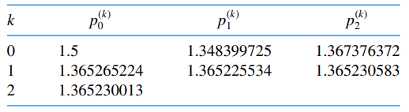
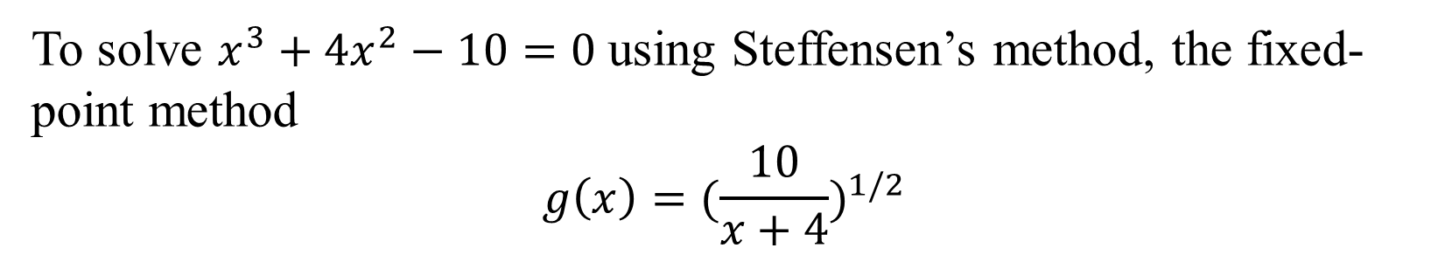
DLI
Illustration
To solve $x^{3}+4x^{2}−10=0$ using Steffensen’s method, the fixed-point method
$$g\left(x\right)={(\frac{10}{x+4})}^{1/2}$$
Applying Steffensen’s procedure with $p_{0}=1.5$ gives the values in Table 2.11.
Table 2.11
From the Illustration, it appears that Steffensen’s method gives quadratic convergence without evaluating a derivative.

Slide 13
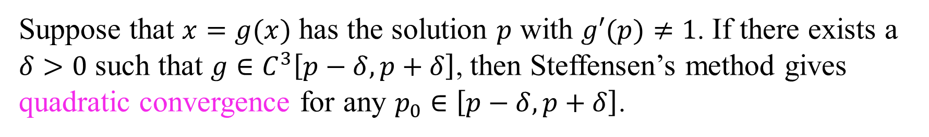
DLI
Theorem 2.15
Suppose that $x=g(x)$ has the solution $p$ with $g′(p)≠1$. If there exists a $δ>0$ such that $g∈C^{3}\left[p−δ,p+δ\right]$, then Steffensen’s method gives quadratic convergence for any $p_{0}∈\left[p−δ,p+δ\right]$.

